Slide 1



Book Worm: Unleashing the Power of AI on Book Recommendation
Maryam Nozari, PhD
May 2023

Slide 2

Data Science Method
Problem Identification
Data Wrangling
Exploratory Data Analysis
Pre-Processing and Training Data Development
Modeling
Documentation
Notes:
Problem Identification
Identify the Problem
Data Wrangling
Collect, organize, define, and clean the dataset
Exploratory Data Analysis
Understand the relationship between data and features
Pre-Processing
Standardize and train the dataset
Modeling
Select train and deploy a model to make predictive insight
Documentation
Document and share findings

Slide 3

With millions of books available on the Goodreads platform, it is overwhelming for users to find books that match their preferences.
Problem Identification
Data Wrangling
Exploratory Data Analysis
Pre-Processing and Data Development
Modeling
Documentation
Problem

Slide 4
Problem Identification
Data Wrangling
Exploratory Data Analysis
Pre-Processing and Data Development
Modeling
Documentation
Goal
This project aims to build a book recommendation system for Goodreads users, which suggests books based on their reading history, preferences, and ratings.

Slide 5



Problem Identification
Data Wrangling
Exploratory Data Analysis
Pre-Processing and Data Development
Modeling
Documentation
Data Acquisition
UCSD Book Graph
Meta-data of the books
User-book interactions
Users' detailed book reviews

Slide 6
Problem Identification
Data Wrangling
Exploratory Data Analysis
Pre-Processing and Data Development
Modeling
Documentation
Data Acquisition
UCSD Book Graph
Meta-data of the books
goodreads_books.json.gz
User book interactions
Users' detailed book reviews
Notes:
Data Extracted from UCSD Goodreads data: https://sites.google.com/eng.ucsd.edu/ucsdbookgraph/home

Slide 7

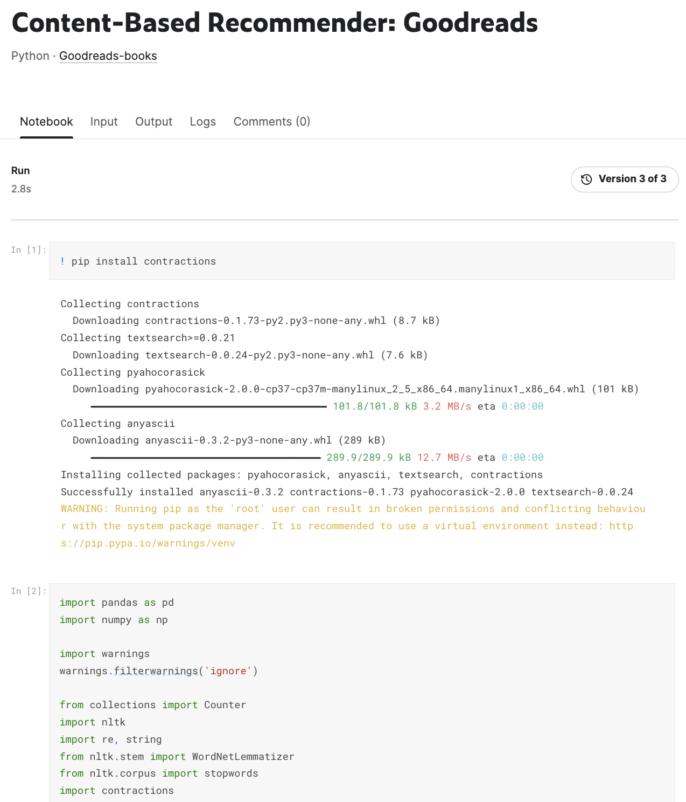
Problem Identification
Data Wrangling
Exploratory Data Analysis
Pre-Processing and Data Development
Modeling
Documentation
Data Organization
UCSD Book Graph
Meta-data of the books
goodreads_books.json.gz
User book interactions
Users' detailed book reviews
Notes:
684.8 MB

Slide 8
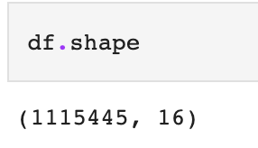
Problem Identification
Data Wrangling
Exploratory Data Analysis
Pre-Processing and Data Development
Modeling
Documentation
Data Shape
UCSD Book Graph
Meta-data of the books
goodreads_books.json.gz
User book interactions
Users' detailed book reviews
Notes:
Limiting the dataset to the first 20000 books with high ratings

Slide 9
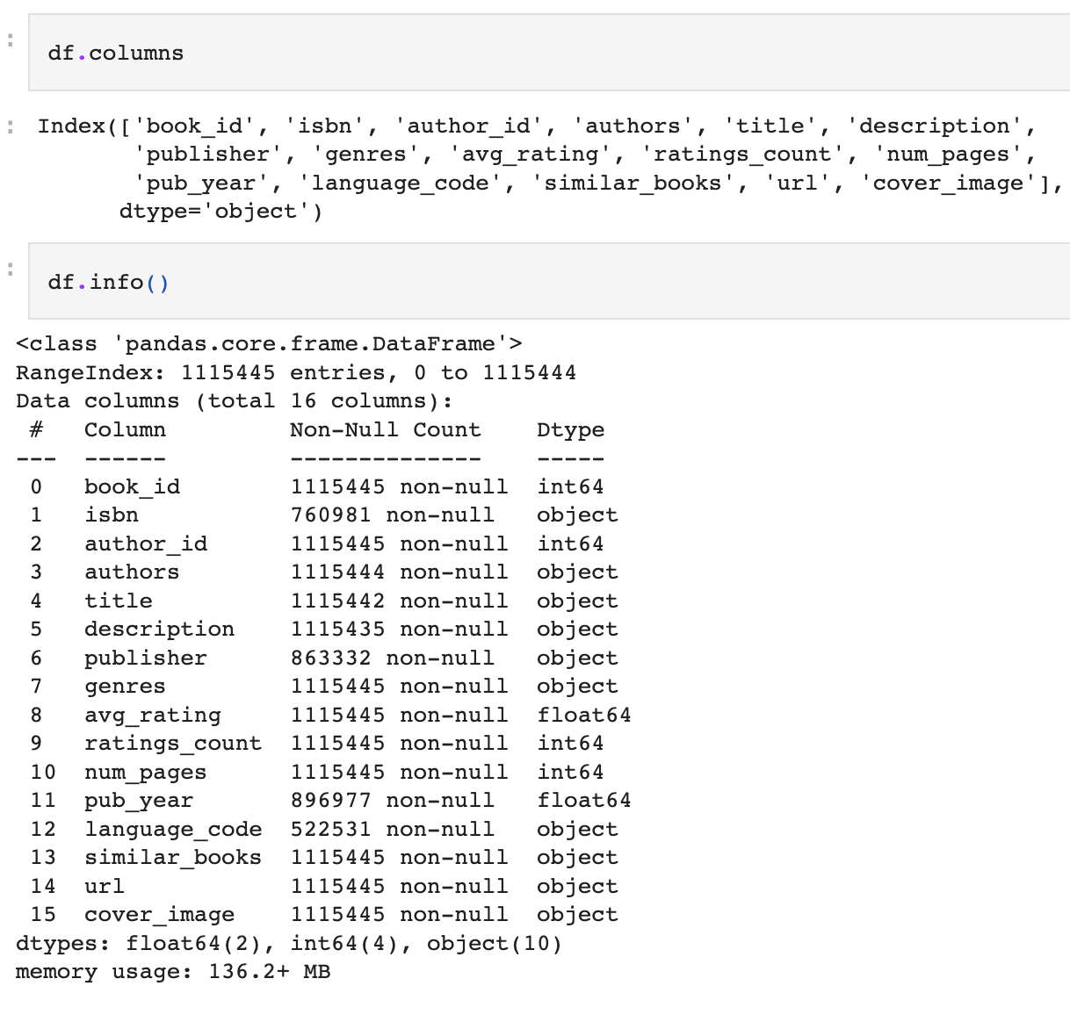
Problem Identification
Data Wrangling
Exploratory Data Analysis
Pre-Processing and Data Development
Modeling
Documentation
Data Definitions
Columns | Descriptions
book_id | unique ID for each book
author_id | the id(s) for author(s)
authors | Author(s) names
title | titles of the books
description | short description of each book
publisher | publisher of each book
genres | genres given by the users
avg_ratings | average rating decided by the users
rating_count | number of ratings given
num_pages | number of pages of each book
pub_year | the year the book was published
simillar_books | List of similar books
url | the Goodread link
Notes:
The goal of building data definitions is to describe the features in your dataset with enough detail to:
Identify any issues that will require cleaning
Identify the features of your dataset
Begin to understand how those features will support the data science project you have in mind

Slide 10
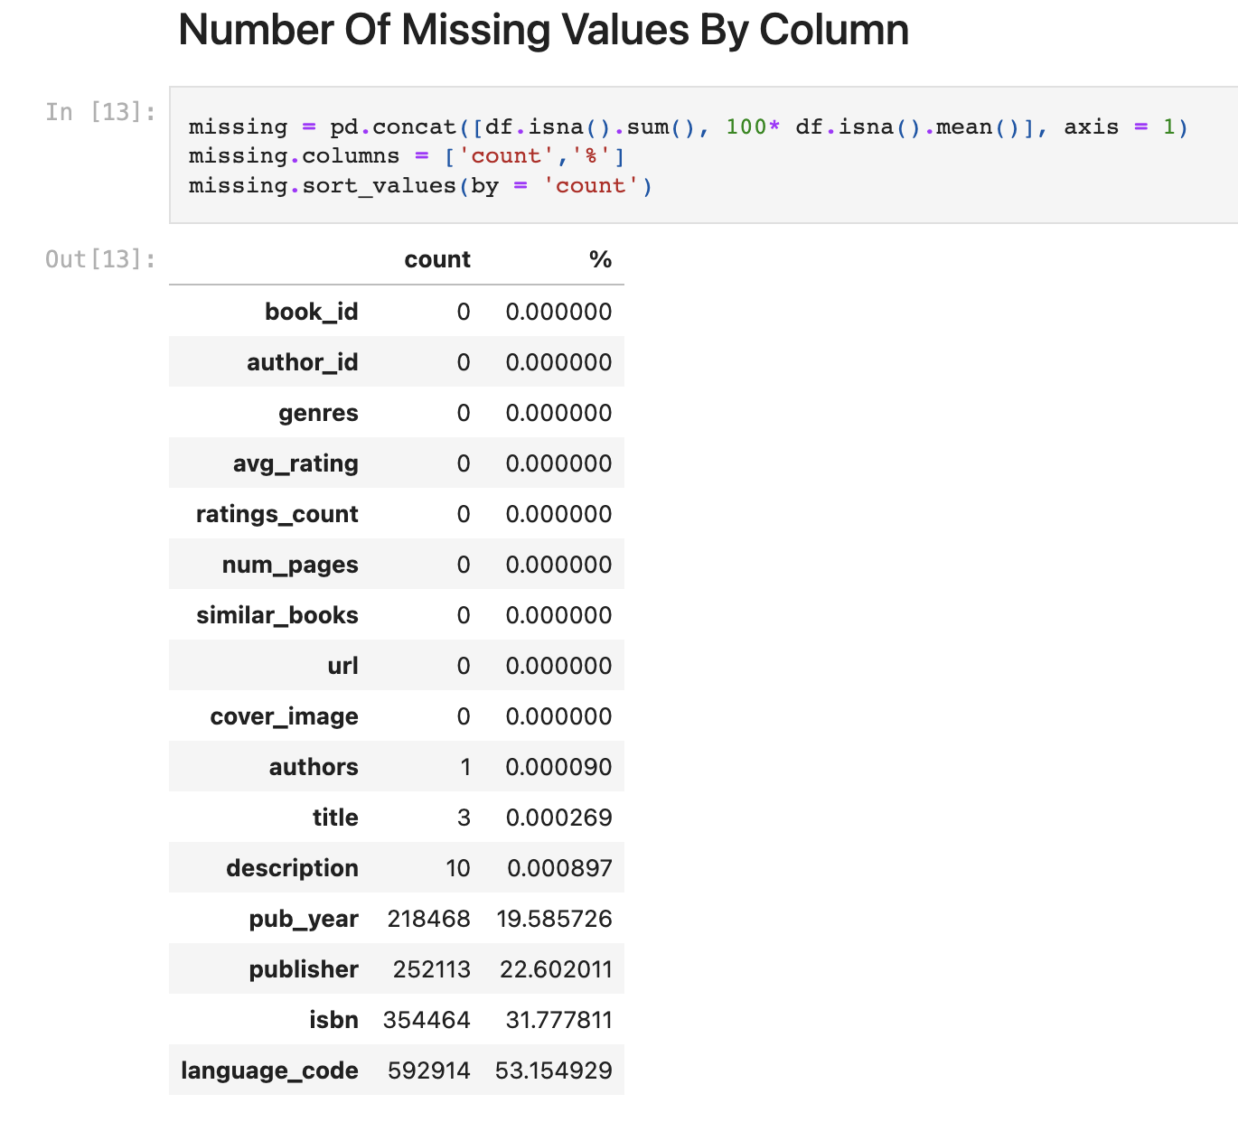
Problem Identification
Data Wrangling
Exploratory Data Analysis
Pre-Processing and Data Development
Modeling
Documentation
Data Quality

Slide 11
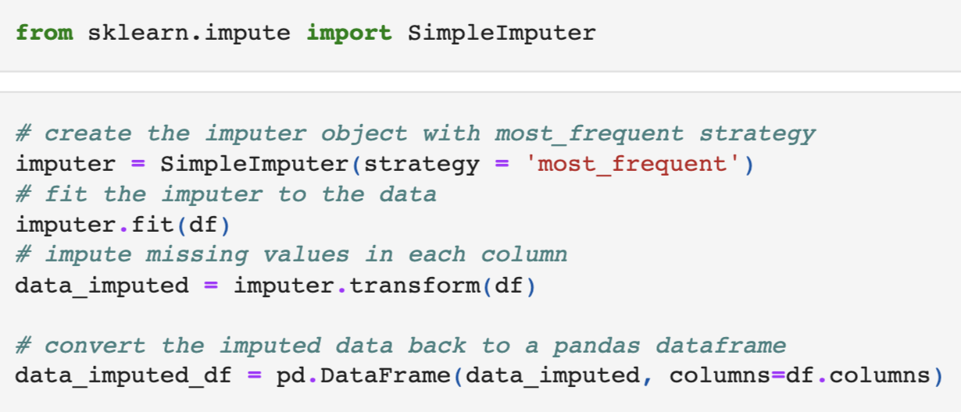
Problem Identification
Data Wrangling
Exploratory Data Analysis
Pre-Processing and Data Development
Modeling
Documentation
Imputing Missing Values

Slide 12
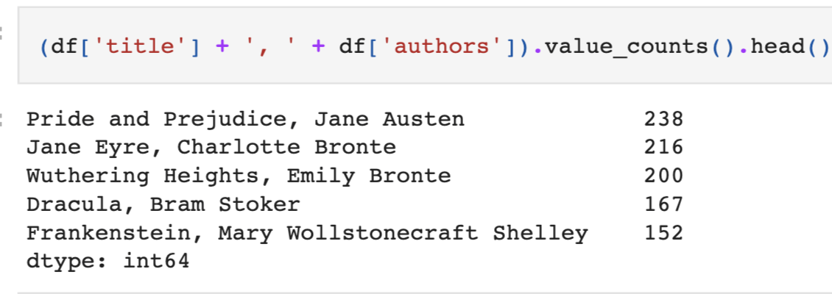
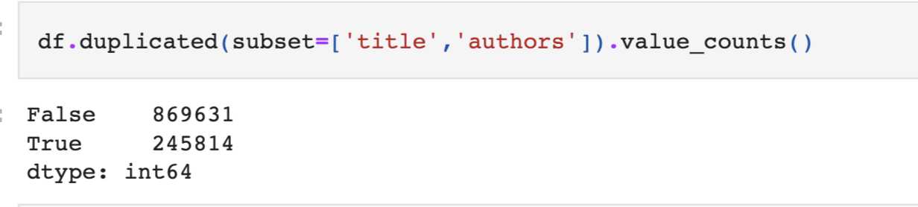
Problem Identification
Data Wrangling
Exploratory Data Analysis
Pre-Processing and Data Development
Modeling
Documentation
Removing Duplicates

Slide 13
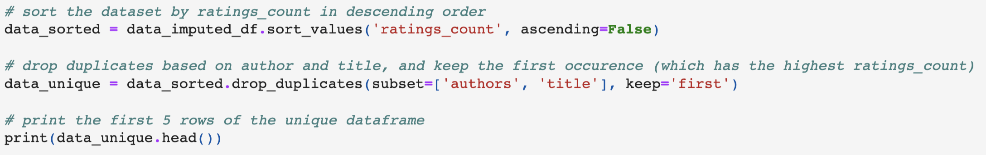
Problem Identification
Data Wrangling
Exploratory Data Analysis
Pre-Processing and Data Development
Modeling
Documentation
Removing Duplicates

Slide 14
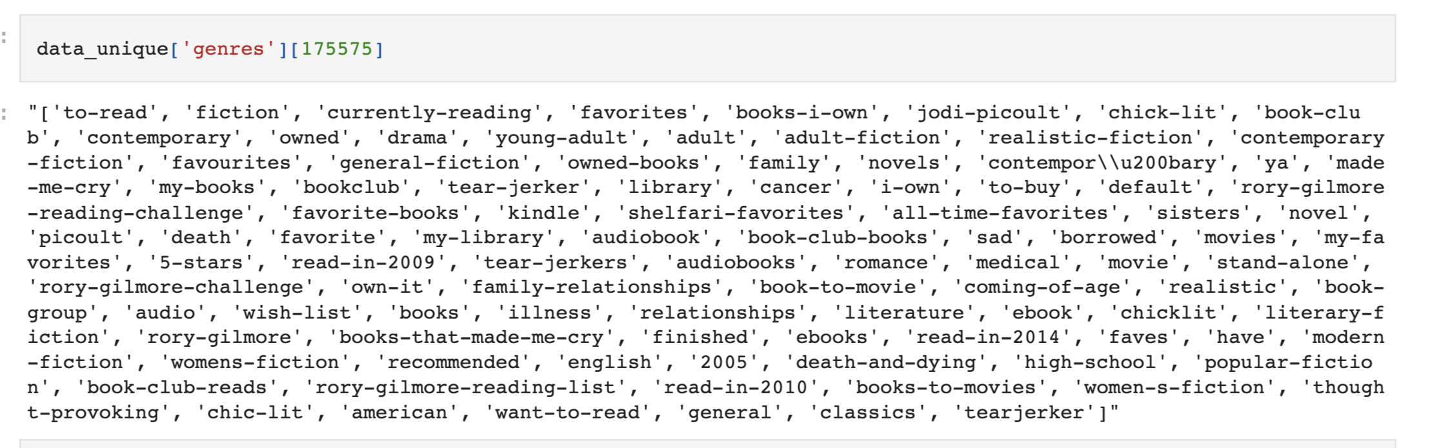
Cleaning the Genres Column
Problem Identification
Data Wrangling
Exploratory Data Analysis
Pre-Processing and Data Development
Modeling
Documentation
Remove space and make all text lowercase.
Stack the columns into a single column and count the frequencies
Notes:
#Remove space and make all text lower case.
# Split the genres column into multiple columns

Slide 15
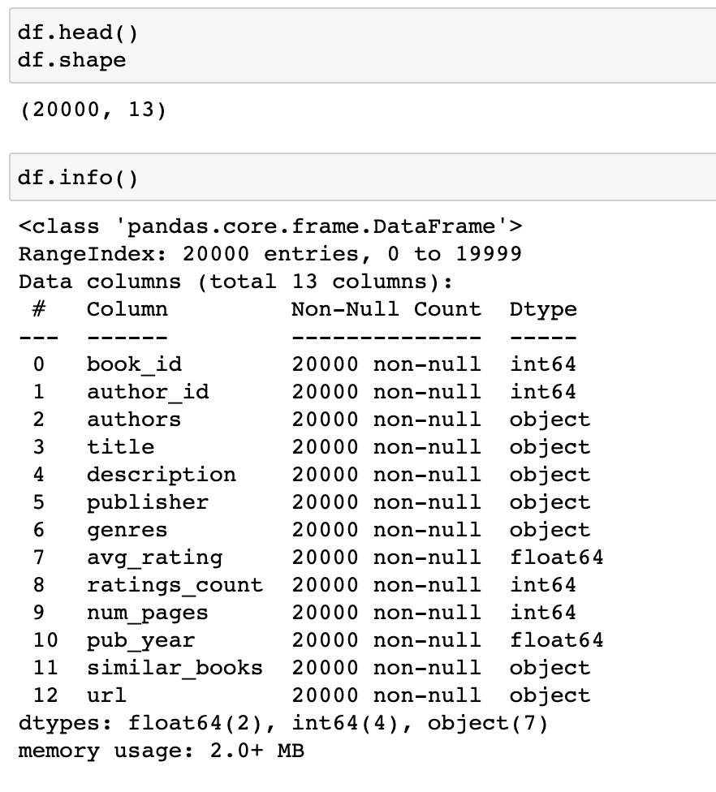
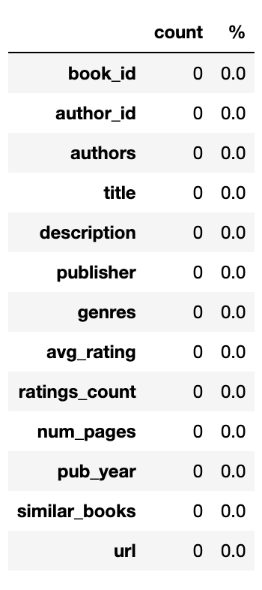
After Cleaning
Problem Identification
Data Wrangling
Exploratory Data Analysis
Pre-Processing and Data Development
Modeling
Documentation
Notes:
#Remove space and make all text lower case.
# Split the genres column into multiple columns

Slide 16
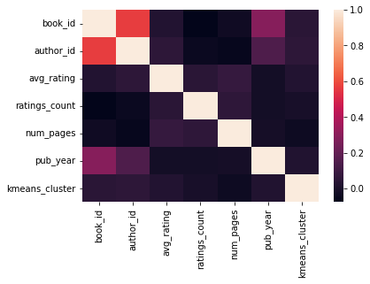
Problem Identification
Data Wrangling
Exploratory Data Analysis
Pre-Processing and Data Development
Modeling
Documentation
Complex Relationship

Slide 17
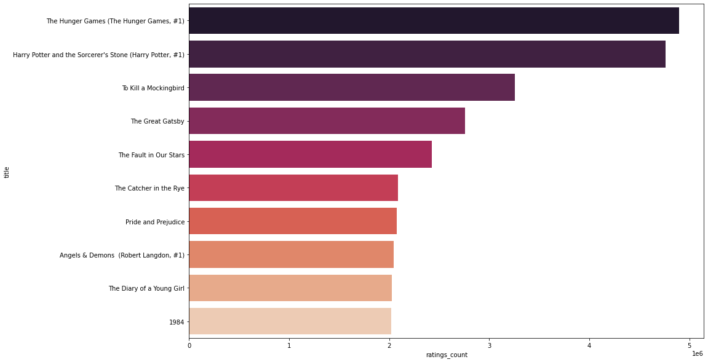
Problem Identification
Data Wrangling
Exploratory Data Analysis
Pre-Processing and Data Development
Modeling
Documentation
Most Rated Books

Slide 18
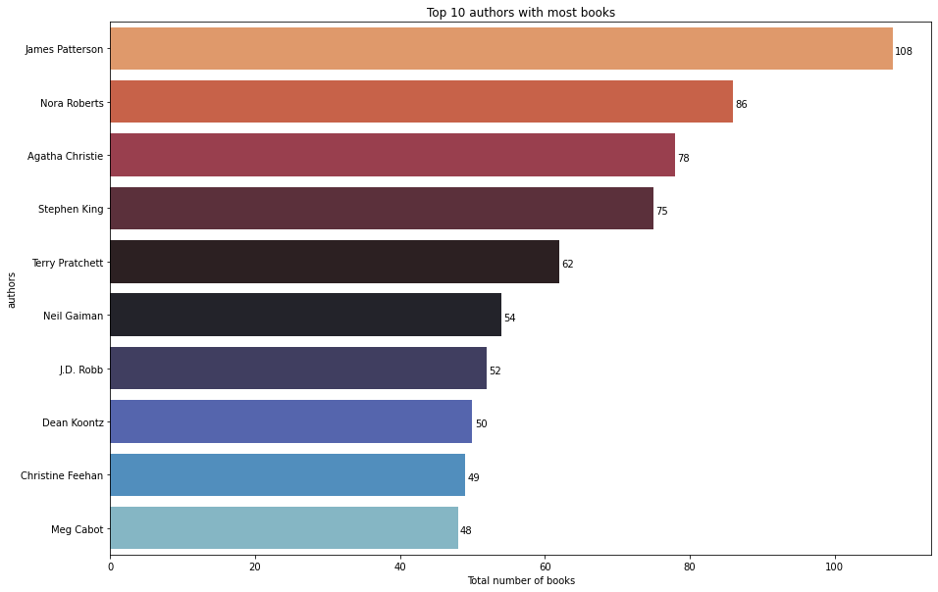
Problem Identification
Data Wrangling
Exploratory Data Analysis
Pre-Processing and Data Development
Modeling
Documentation
Authors with Most Books

Slide 19
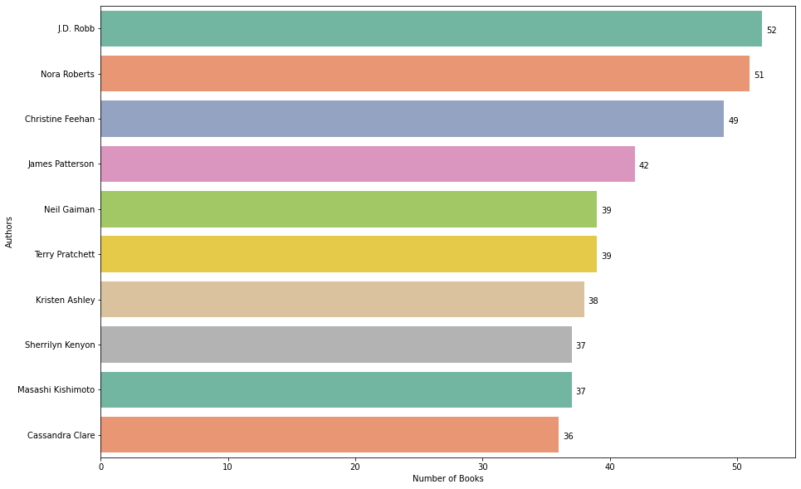
Problem Identification
Data Wrangling
Exploratory Data Analysis
Pre-Processing and Data Development
Modeling
Documentation
Highly Rated Authors

Slide 20
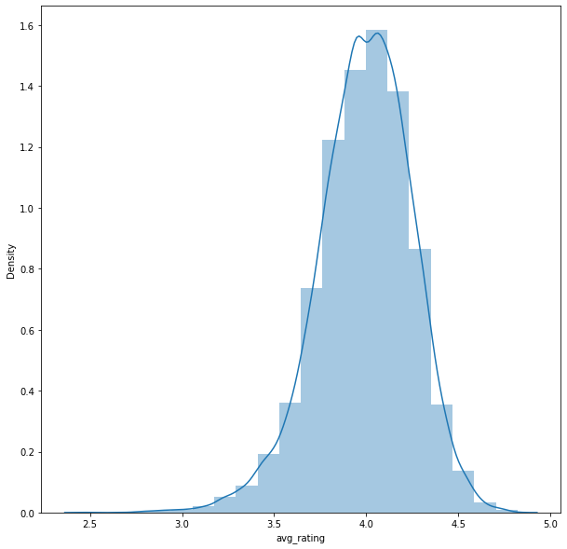
Problem Identification
Data Wrangling
Exploratory Data Analysis
Pre-Processing and Data Development
Modeling
Documentation
Average Rating Plot

Slide 21
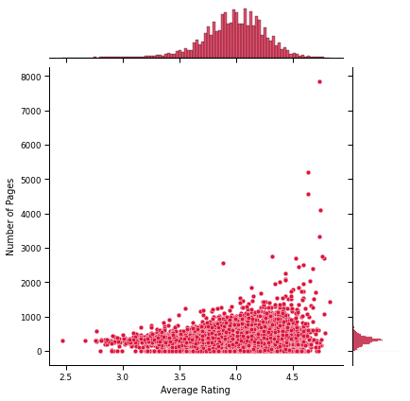
Problem Identification
Data Wrangling
Exploratory Data Analysis
Pre-Processing and Data Development
Modeling
Documentation
Correlation between Number of Pages and Ratings

Slide 22
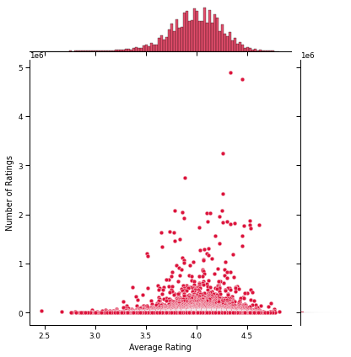
Problem Identification
Data Wrangling
Exploratory Data Analysis
Pre-Processing and Data Development
Modeling
Documentation
Correlation between Number of Ratings and Average Rating

Slide 23
Problem Identification
Data Wrangling
Exploratory Data Analysis
Pre-Processing and Data Development
Modeling
Documentation
Using Natural Language Processing (NLP) to Cluster the books based on the description

Slide 24
Problem Identification
Data Wrangling
Exploratory Data Analysis
Pre-Processing and Data Development
Modeling
Documentation
Step 1: Text Processing
Tokenization: The text in the descriotion column must be parsed and transform into a list of words.
Remove special characters and punctuation
Remove "stop words": Commonly used words without any specific connocation (e.g., "the","a", "an", "in")
Use Natural Language Toolkit (NLTK) and Regular Expressions (RegEx) to clean up and tokenize our text.

Slide 25
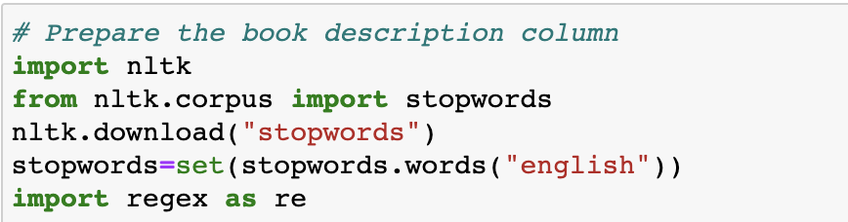
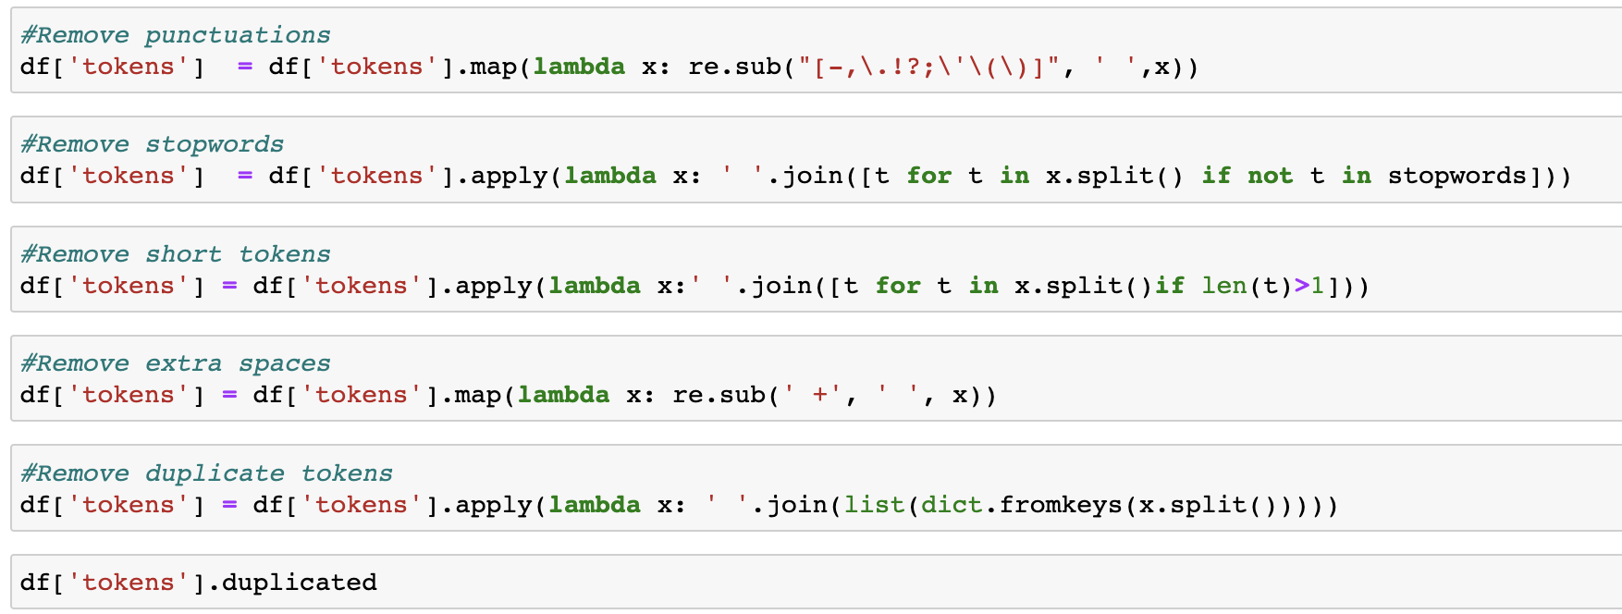
Problem Identification
Data Wrangling
Exploratory Data Analysis
Pre-Processing and Data Development
Modeling
Documentation
Step 1: Text Processing

Slide 26
Problem Identification
Data Wrangling
Exploratory Data Analysis
Pre-Processing and Data Development
Modeling
Documentation
Step 2: Word Embedding
Use Global Vectors for Word Representation (GloVe)
A word2vec model that is to say an unsupervised learning algorithm for obtaining vector representations for words.It allows you to take any corpus of text and transform each word into a position in high-dimensional space.
Download a pretrained model that was trained on a broader corpus(Wikipidia)
Each line of text file contains a word follow by N number. The N number describe the vector of the word position. N is varid depending on which model you choose to download.
Notes:
Use Global Vectors for Word Representation (GloVe): GloVe is a word2vec model that is to say an unsupervised learning algorithm for obtaining vector representations for words.It allows you to take any corpus of text and transform each word into a position in high-dimentional space.
Download a pretrained model that was trained on a broder corpus:Wikipidia Each line of text file contains a word follow by N number. The N number describe the vector of the word position. N is varid depending on which model you choose to download.

Slide 27
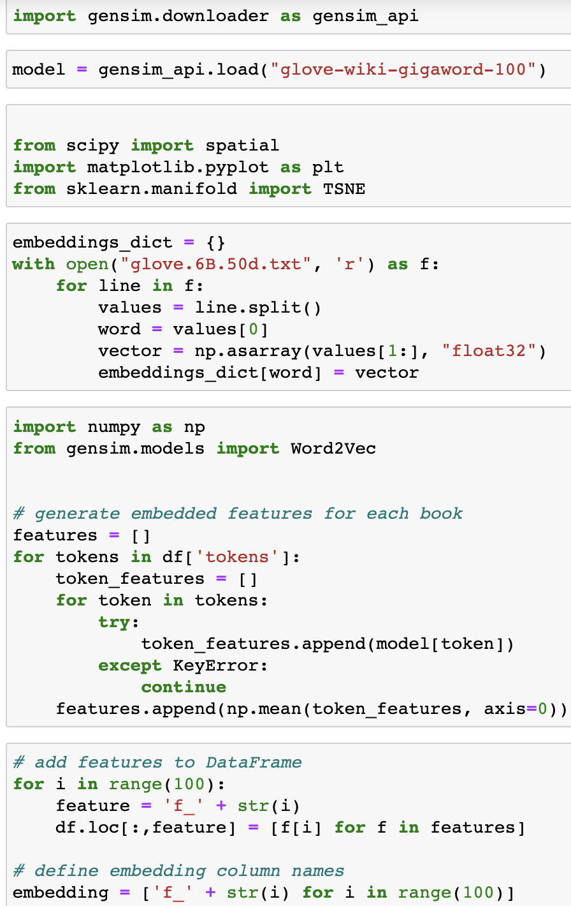
Problem Identification
Data Wrangling
Exploratory Data Analysis
Pre-Processing and Data Development
Modeling
Documentation
Step 2: Word Embedding
Notes:
Use Global Vectors for Word Representation (GloVe): GloVe is a word2vec model that is to say an unsupervised learning algorithm for obtaining vector representations for words.It allows you to take any corpus of text and transform each word into a position in high-dimentional space.
Download a pretrained model that was trained on a broder corpus:Wikipidia Each line of text file contains a word follow by N number. The N number describe the vector of the word position. N is varid depending on which model you choose to download.

Slide 28
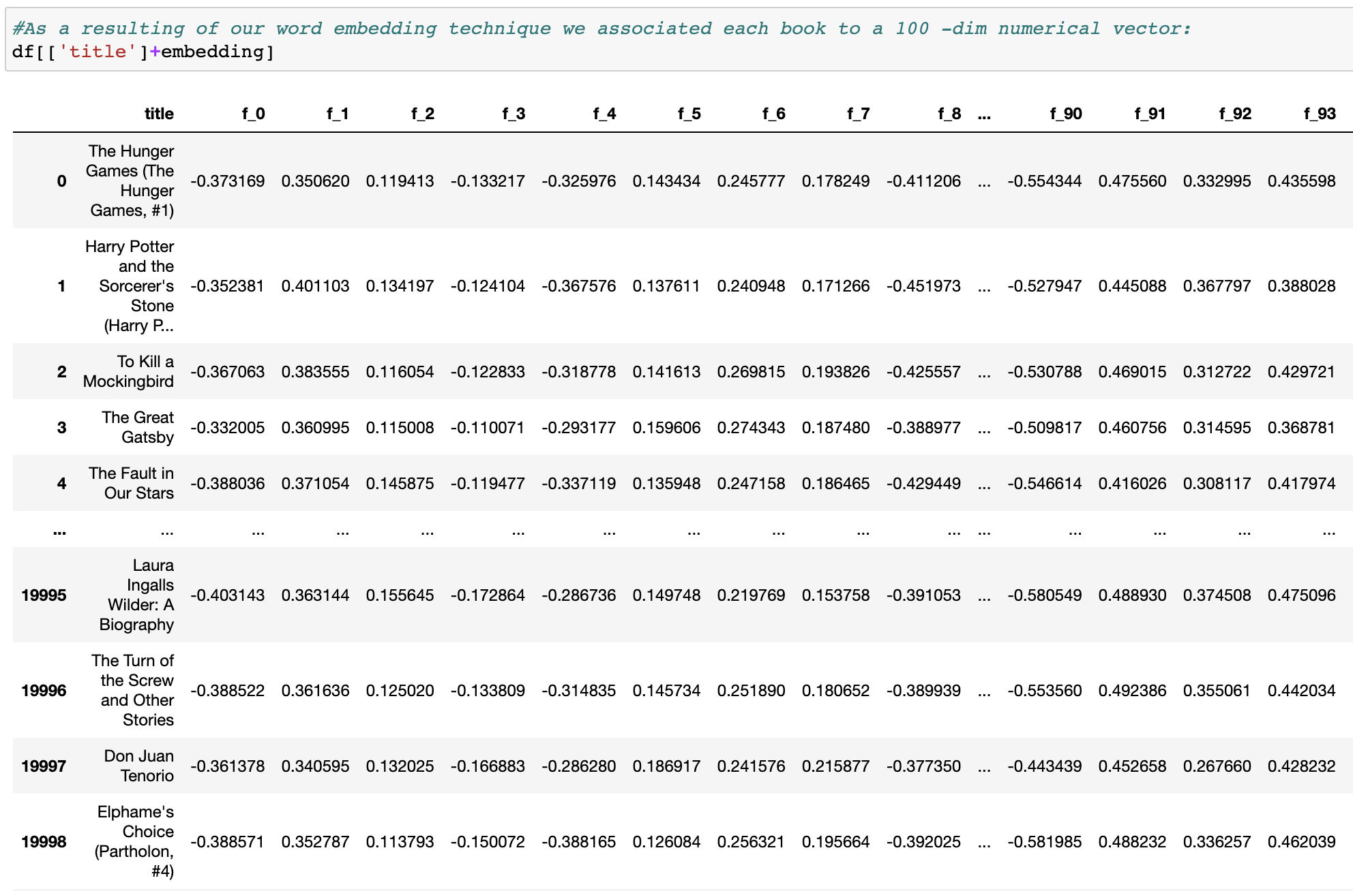
Problem Identification
Data Wrangling
Exploratory Data Analysis
Pre-Processing and Data Development
Modeling
Documentation
Step 2: Word Embedding
Notes:
Use Global Vectors for Word Representation (GloVe): GloVe is a word2vec model that is to say an unsupervised learning algorithm for obtaining vector representations for words.It allows you to take any corpus of text and transform each word into a position in high-dimentional space.
Download a pretrained model that was trained on a broder corpus:Wikipidia Each line of text file contains a word follow by N number. The N number describe the vector of the word position. N is varid depending on which model you choose to download.

Slide 29
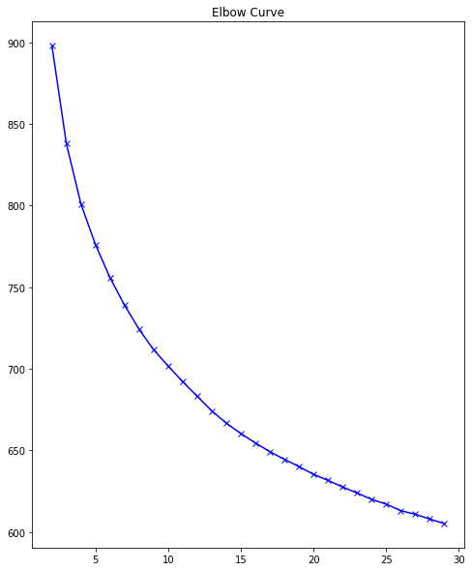
Problem Identification
Data Wrangling
Exploratory Data Analysis
Pre-Processing and Data Development
Modeling
Documentation
Step 3: KMeans Clustering (Choosing K using Elbow Method
Notes:
Now that we have represented each book by a point in a multidimentional space, we can use the distance between each books to find out which books are similar to each other.

Slide 30
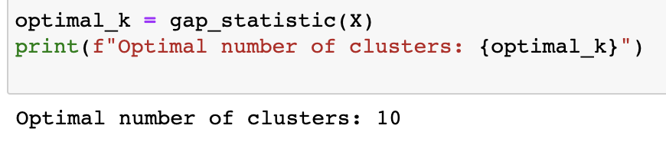
Problem Identification
Data Wrangling
Exploratory Data Analysis
Pre-Processing and Data Development
Modeling
Documentation
Step 3: KMeans Clustering (Choosing K using Gap Statistics)
Notes:
Now that we have represented each book by a point in a multidimentional space, we can use the distance between each books to find out which books are similar to each other.

Slide 31
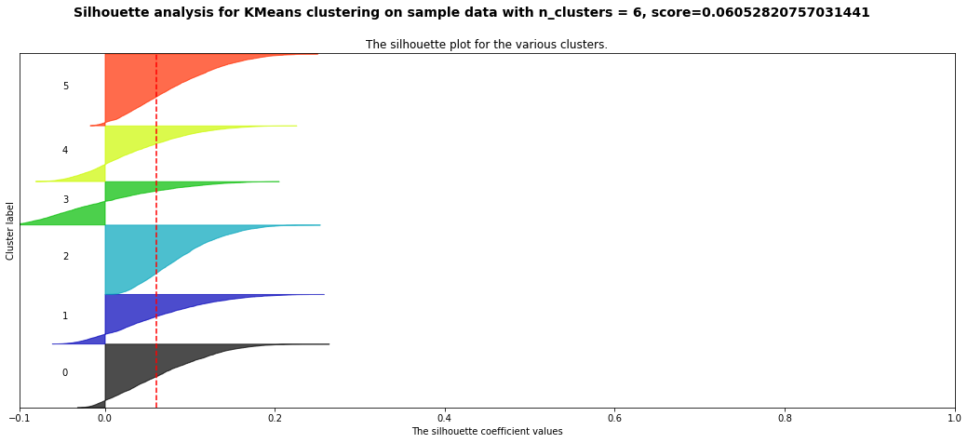
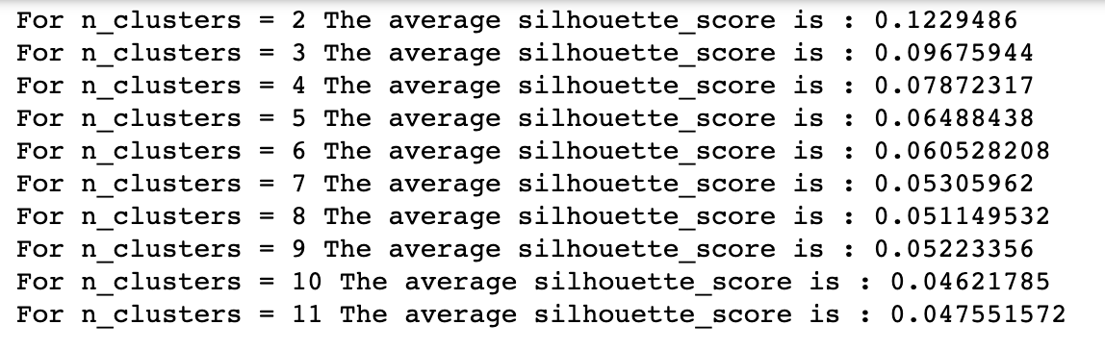
Problem Identification
Data Wrangling
Exploratory Data Analysis
Pre-Processing and Data Development
Modeling
Documentation
Step 3: KMeans Clustering (Choosing K using Silhouette Method)
Notes:
Now that we have represented each book by a point in a multidimentional space, we can use the distance between each books to find out which books are similar to each other.
KMeans Clustering (Choosing K using Gap Statistics) 10

Slide 32
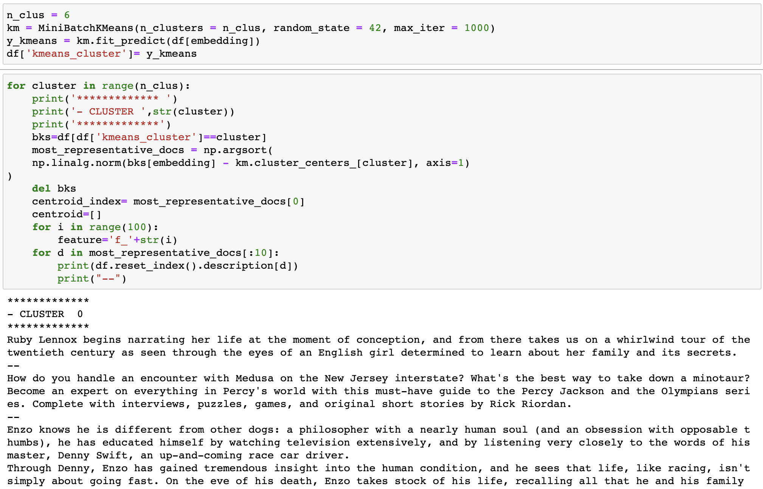
Problem Identification
Data Wrangling
Exploratory Data Analysis
Pre-Processing and Data Development
Modeling
Documentation
Step 4: KMeans (Cluster Profiling)
Notes:
Now that we have represented each book by a point in a multidimentional space, we can use the distance between each books to find out which books are similar to each other.
KMeans Clustering (Choosing K using Gap Statistics) 10

Slide 33
Problem Identification
Data Wrangling
Exploratory Data Analysis
Pre-Processing and Data Development
Modeling
Documentation
Step 3: KMeans (Cluster Profiling)
Notes:
Now that we have represented each book by a point in a multidimentional space, we can use the distance between each books to find out which books are similar to each other.
KMeans Clustering (Choosing K using Gap Statistics) 10

Slide 34
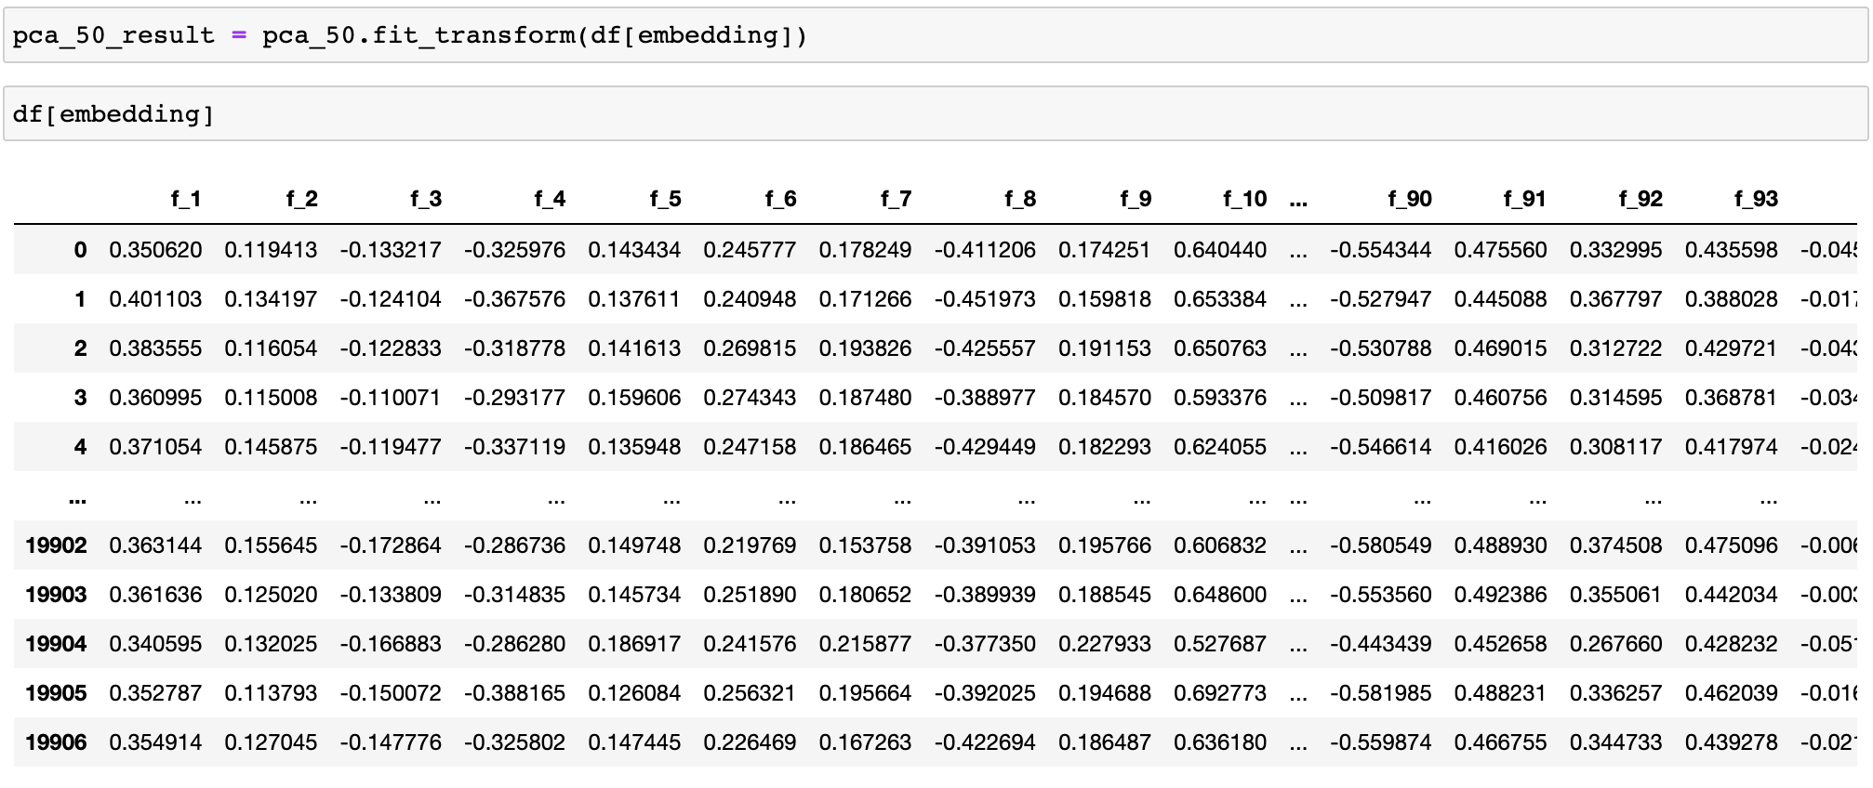
Problem Identification
Data Wrangling
Exploratory Data Analysis
Pre-Processing and Data Development
Modeling
Documentation
Step 4: Reducing Variables using PCA
To visualize high-dimensional datasets we used techniques of dimensionality reduction.

Slide 35
Problem Identification
Data Wrangling
Exploratory Data Analysis
Pre-Processing and Data Development
Modeling
Documentation
Step 4: Execute TSNE Model

Slide 36
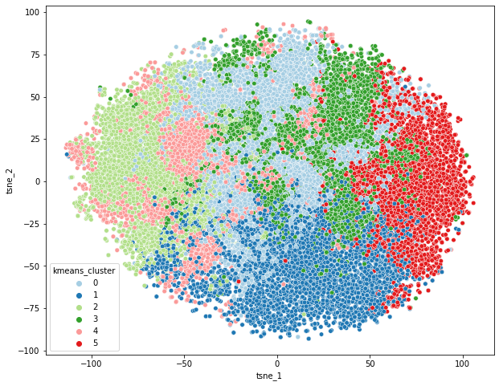
Problem Identification
Data Wrangling
Exploratory Data Analysis
Pre-Processing and Data Development
Modeling
Documentation
Step 5: Cluster Visualization

Slide 37
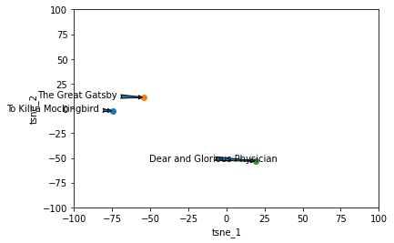
Problem Identification
Data Wrangling
Exploratory Data Analysis
Pre-Processing and Data Development
Modeling
Documentation
Sample Titles
sample_titles

Slide 38
Problem Identification
Data Wrangling
Exploratory Data Analysis
Pre-Processing and Data Development
Modeling
Documentation
Building Recommendation Systems

Slide 39
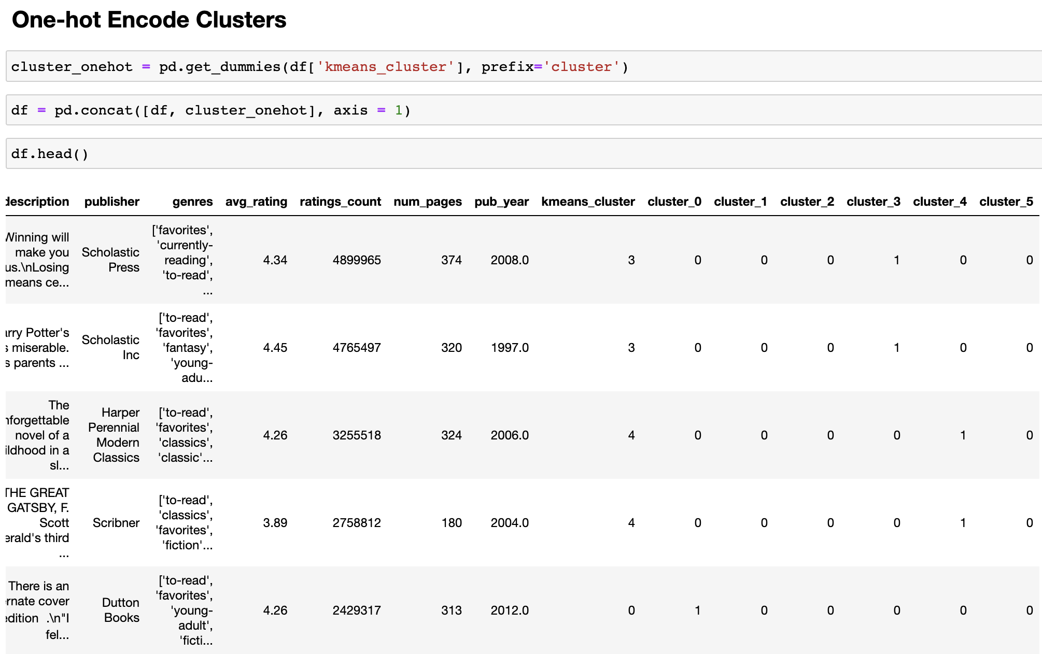
Problem Identification
Data Wrangling
Exploratory Data Analysis
Pre-Processing and Data Development
Modeling
Documentation
One-hot Encode Clusters

Slide 40
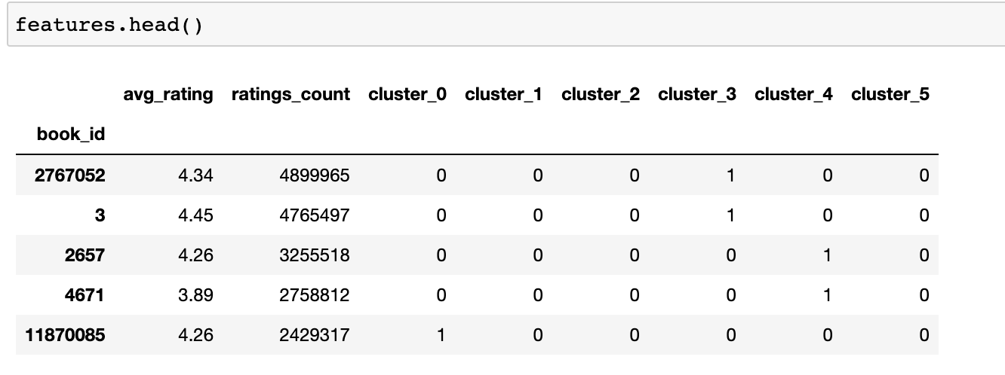
Problem Identification
Data Wrangling
Exploratory Data Analysis
Pre-Processing and Data Development
Modeling
Documentation
Recommendation Engine

Slide 41
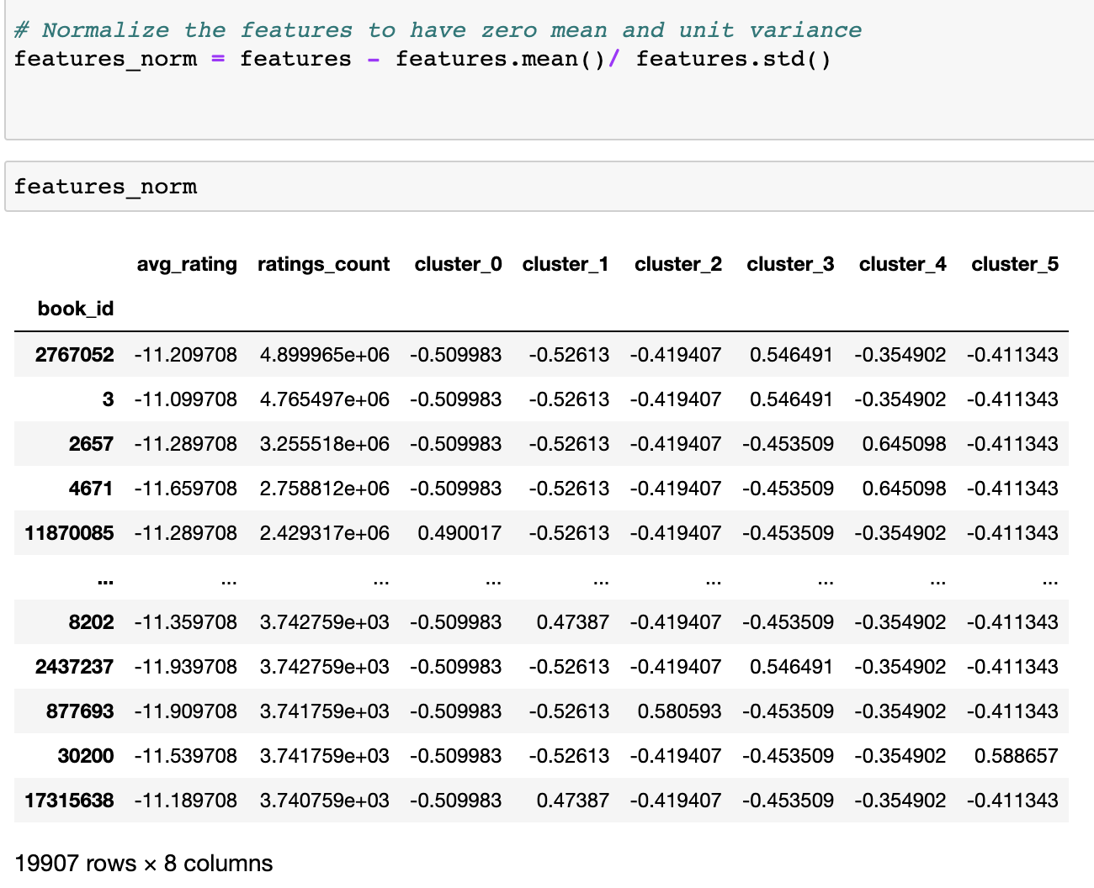
Problem Identification
Data Wrangling
Exploratory Data Analysis
Pre-Processing and Data Development
Modeling
Documentation
Recommendation Engine Using Euclidean Distance Matrix

Slide 42
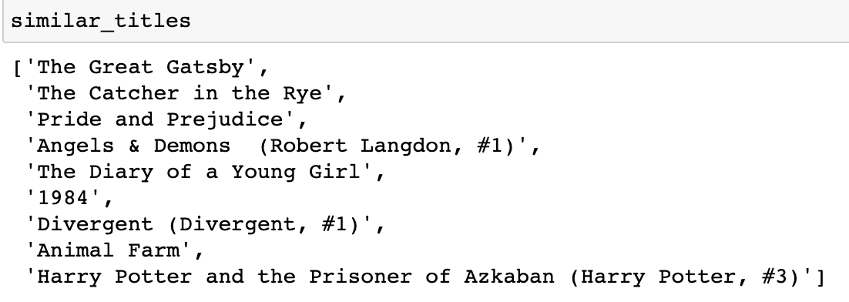
Problem Identification
Data Wrangling
Exploratory Data Analysis
Pre-Processing and Data Development
Modeling
Documentation
Recommendation Engine Using Euclidean Distance Matrix

Slide 43
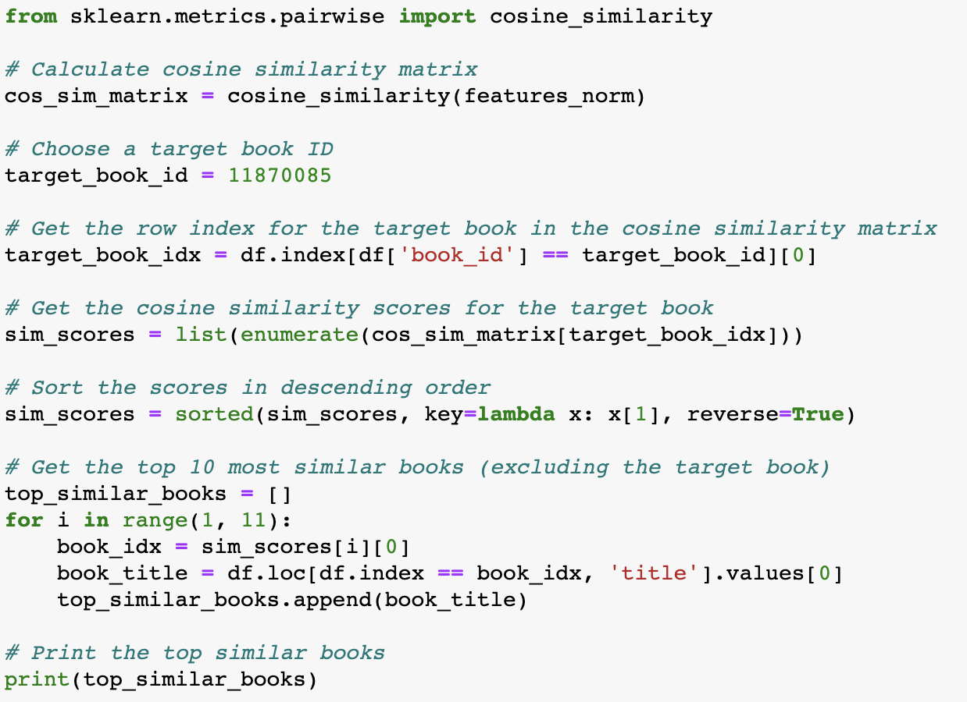
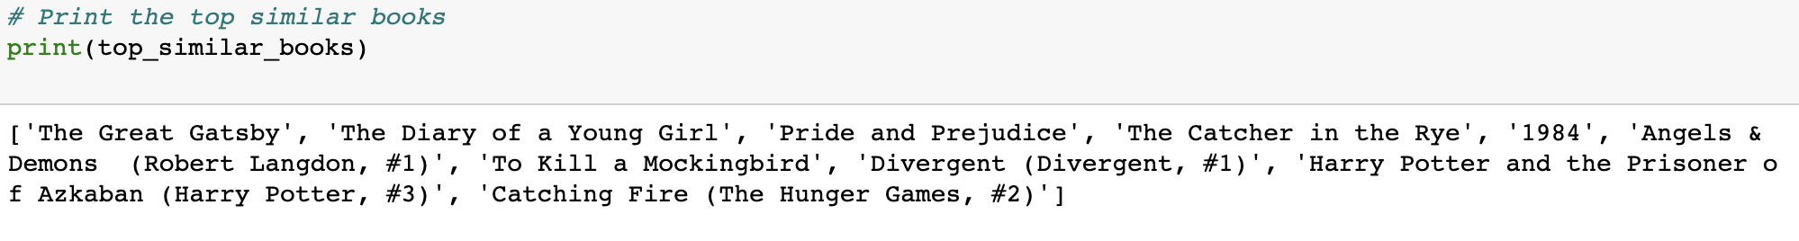
Problem Identification
Data Wrangling
Exploratory Data Analysis
Pre-Processing and Data Development
Modeling
Documentation
Recommendation Engine Using Cosine Similarity

Slide 44
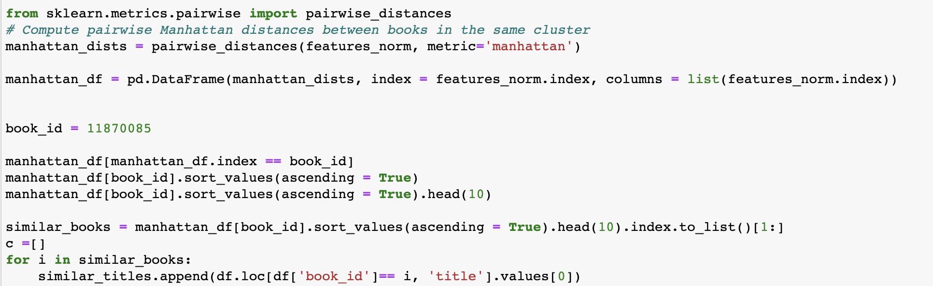
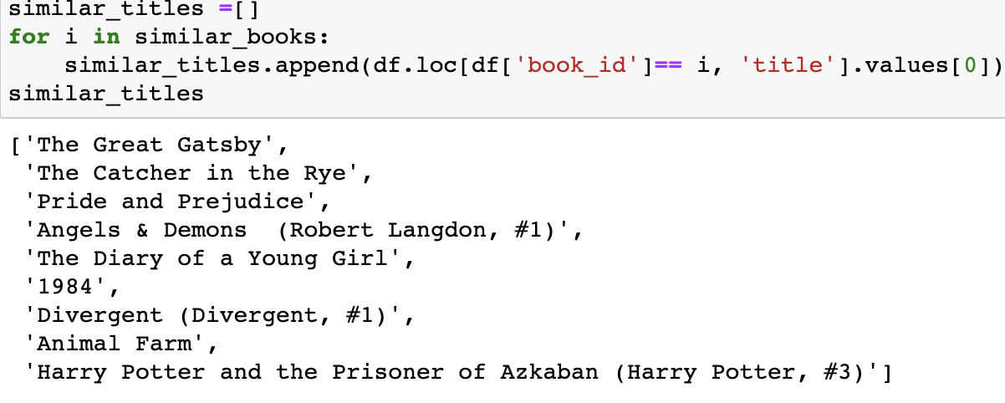
Problem Identification
Data Wrangling
Exploratory Data Analysis
Pre-Processing and Data Development
Modeling
Documentation
Recommendation Engine Using Manhattan

Slide 45
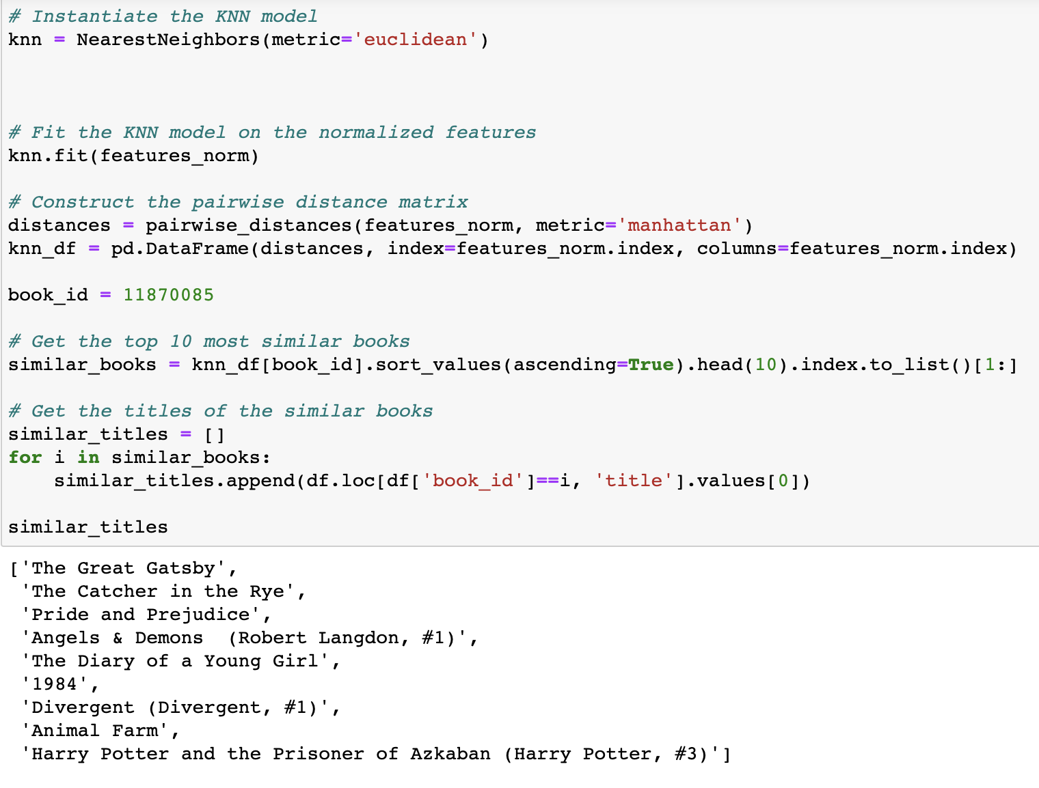
Problem Identification
Data Wrangling
Exploratory Data Analysis
Pre-Processing and Data Development
Modeling
Documentation
Recommendation Engine Using K Nearest Neighbors

Slide 46
Summary
Problem Identification
Data Wrangling
Exploratory Data Analysis
Pre-Processing and Data Development
Modeling
Documentation

